Slide 1
Expression Classification from Facial Images
Shazia Sifat

Slide 2
Overview
Learning discriminative features for expressions from facial images captured in the wild is a non-trivial task due to intra-class variations and inter-class similarities.
expressions can be useful for Human-Computer Interaction based recommendation systems to determine whether to push product information or not.

Slide 3
Dataset Preparation
Download and Extract Using Archive Manager
Necessary Python Packages
Seaborn
Tensorflow
OpenCV-Python
Matplotlib
Pandas
Numpy

Slide 4
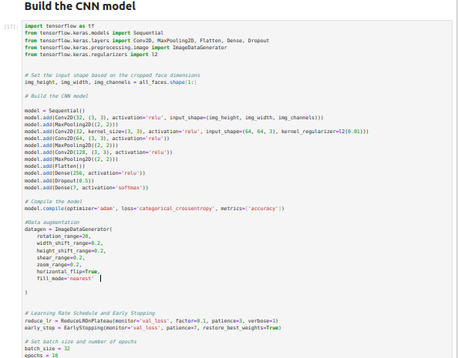
Model development

Slide 5
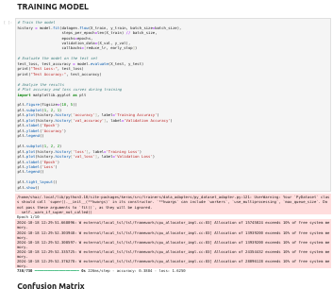
Training, Testing and Evaluation

